Slide 1

MakeMyTrip SQL Project: Data Insights for Travel
Data analysis using SQL (MS SQL Server)

Slide 2
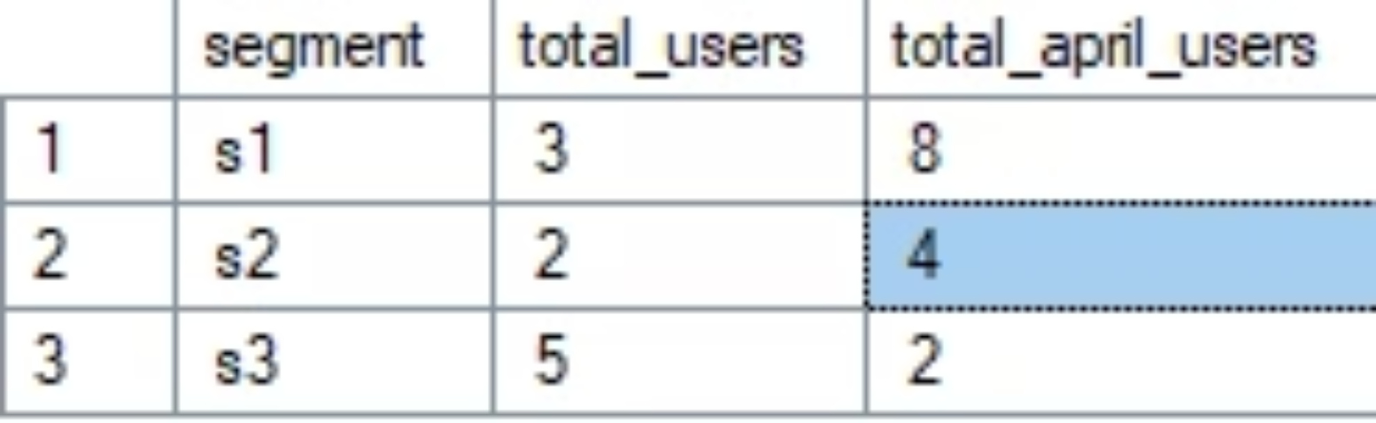

Q1. Write a sql query to show, for each segment, the total number of user s na d the number of users who boooked flight in april 2022.
select u.segment, count(distinct u.user_id) as total_users, count(case when DATEPART(year, b.booking_date) = '2022' AND DATEPART(month, b.booking_date) = '4' Then u.user_id else null end) as total_april_users from user_table as u left join booking_table as b on u.user_id = b.user_id group by u.segment;

Slide 3
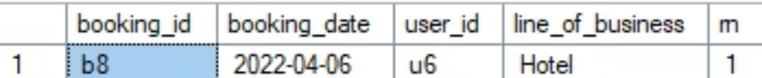
Q2, Write a query to identify users whose first booking was a hotel booking.
Select * from ( select *, row_number() over(partition by user_id order by booking_date) as rn from booking_table ) t where rn = 1 and line_of_business = 'Hotel';

Slide 4
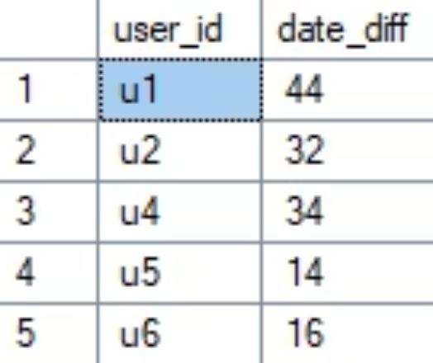

Q-3. Write query to calculate the number of days between the first and last booking of the new user.
select user_id, datediff(day,min(booking_date), max(booking_date)) as date_diff -- datediff(day, min_bookindate, max_booking_date) from booking_table where user_id = 'u1' group by user_id

Slide 5
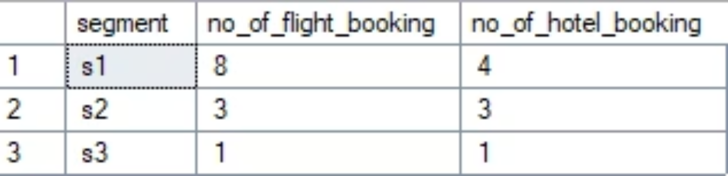
Q4. write a query to coun thte number of flight and hotel bookin in each of the user
segments for the year of 2022;
select u.segment, sum(case when b.line_of_business = 'Flight' then 1 else 0 end) as no_of_flight_booking, sum(case when b.line_of_business = 'Hotel' then 1 else 0 end) as no_of_hotel_booking from user_table u inner join booking_table b on u.user_id = b.user_id where DATEPART(Year,b.booking_date) = '2022' group by u.segment;

Slide 6
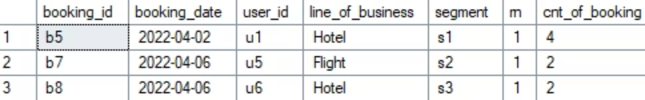
Q5. For each segment, the user who made the earlist booking in april 2022, and also return ,How many total bookin that user made in april 2022.
with cte as ( SELECT b.,u.segment, ROW_NUMBER() over(partition by u.segment order by b.booking_date, b.booking_id) as rn, count() over(partition by u.segment, u.user_id) as cnt_of_booking FROM user_table as u join booking_table as b on u.user_id = b.user_id where datepart(month, b.booking_date) = '04' and DATEPART(year, b.booking_date) = '2022') select* from cte where rn = 1;

